Slide 1
LISTENING
PRESENTED BY
MADHURIMA RAWAT
ROLL NO-29
DATASCIENCE(CSE)
CHHATTISGARH SWAMI VIVEKANANDA TECHNICAL UNIVERSITY

Slide 2
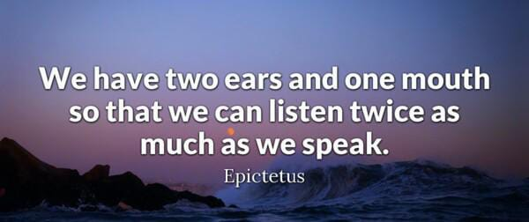
IN WORDS OF PHILOSOPHER EPICTATUS

Slide 3
DEFINATION OF LISTENING
To listen is to give attention to sound or action. When listening, one is hearing what others are saying, and trying to understand what it means.The act of listening involves complex affective, cognitive and behavioral processes.[Affective processes include the motivation to listen to others; cognitive processes include attending to, understanding, receiving and interpreting content and relational messages; and behavioral processes include responding to others with verbal and nonverbal feedback.

Slide 4
LISTENING Vs HEARING
Hearing is the act of perceiving sound and receiving sound waves or vibrations through your ear. | Listening is the act of hearing a sound and understanding what you hear.
Hearing is one of the five senses and it just happens all the time – whether you like it or not – unless you have a hearing problem | Listening Requires concentration so that your brain processes meaning from words and sentences.
Hearing simply happens. | Listening leads to learning.
Hearing is a skill where you use your ears only. It one of the five senses. | Listening uses different senses, like the sense of hearing, seeing, or sense of touch.
Hearing is an involuntary act where you simply receive vibrations through your ears. | Listening is a skill that lets the sound you hear go through your brain to process the meaning of it.
Physiological | Psychological
Subconscious level | Conscious level
Concentration is not required | Concentration is required

Slide 5
NATURE OF LISTENING
Nature of Listening Listening is the cognitive process whereby we attach meanings to aural signals. It is the active intellectual process of decoding, interpreting, understanding and evaluating messages. It is a mode of communication just as important as the other modes like speaking, reading, and writing.

Slide 6
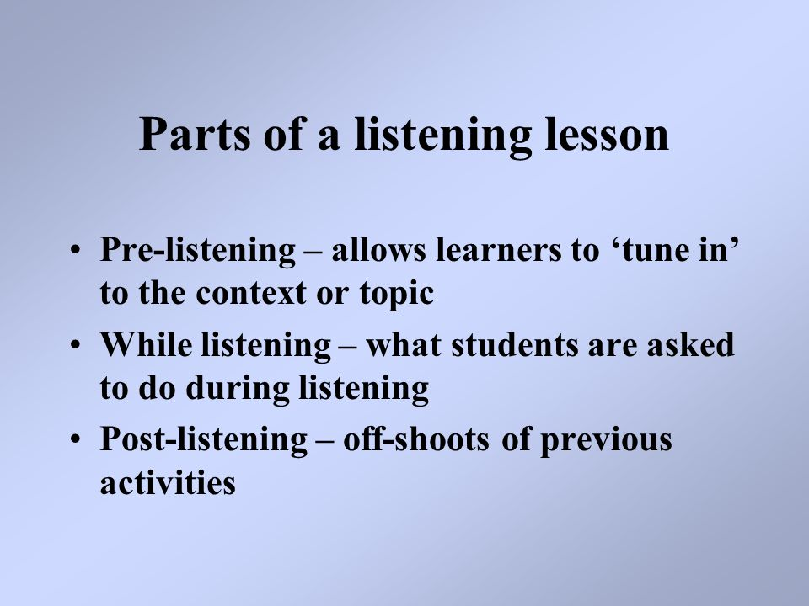

STAGES OF LISTENING

Slide 7
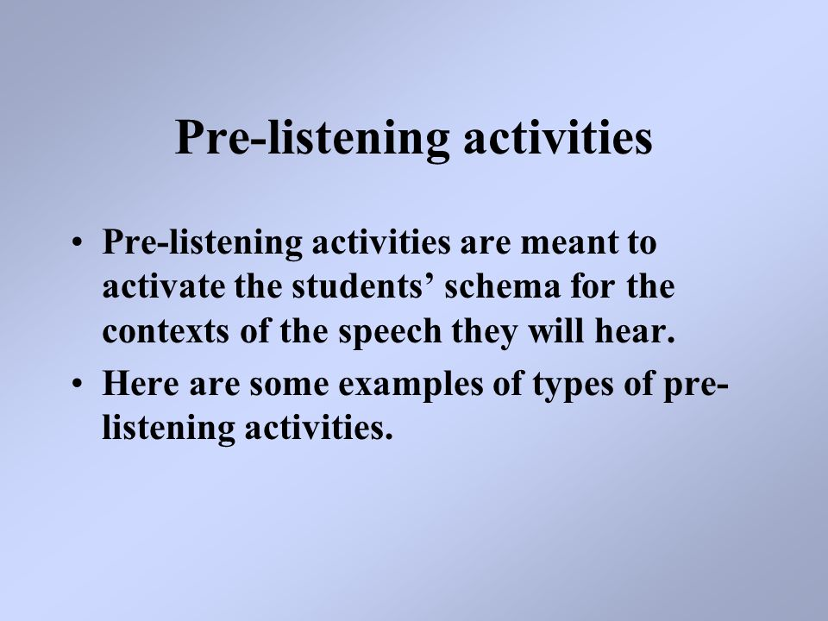
PRE –LISTENING STAGE

Slide 8
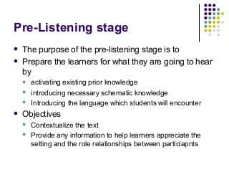
CONTINUATION

Slide 9
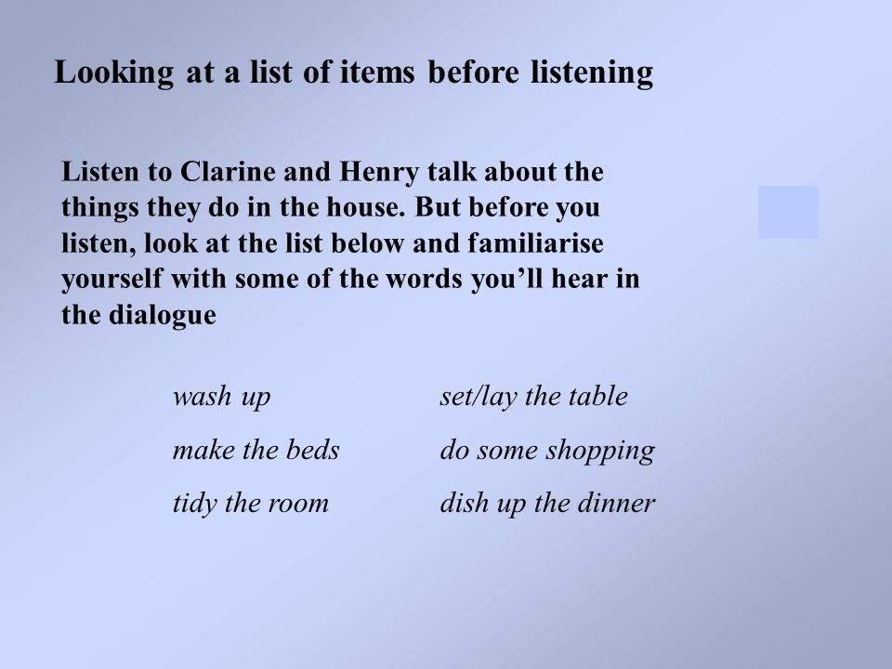
EXAMPLE

Slide 10
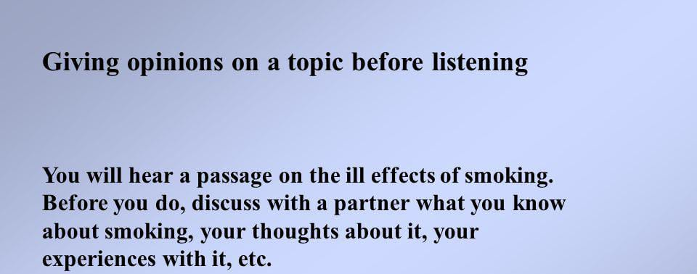
MORE EXAMPLES

Slide 11
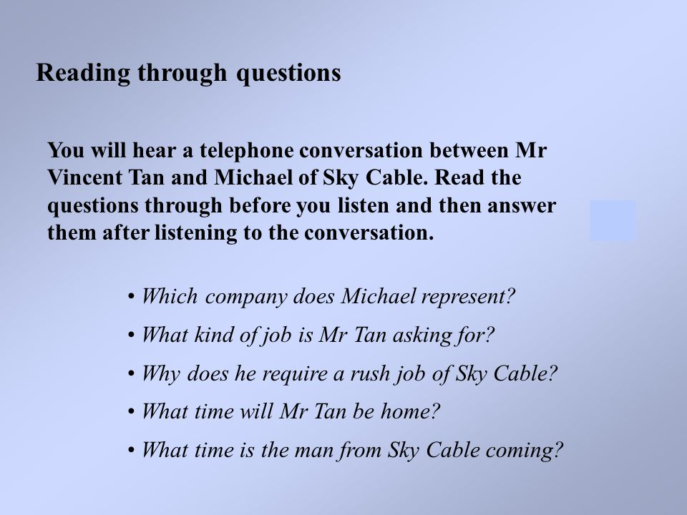
NEXT EXAMPLE

Slide 12
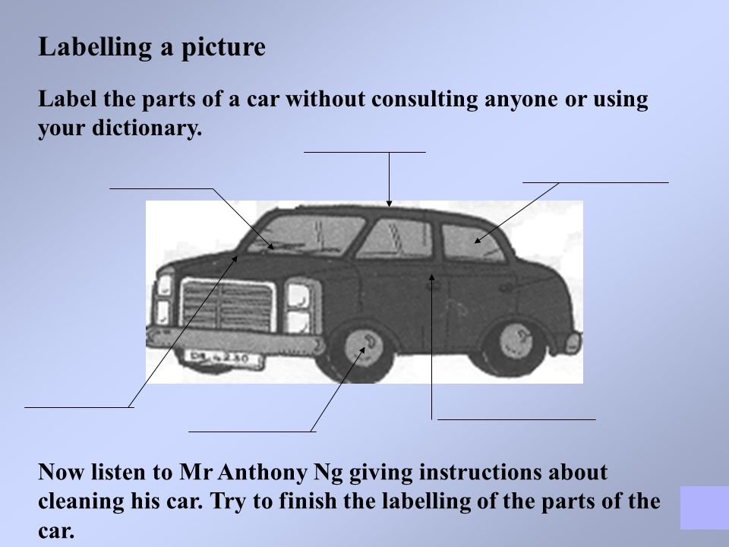
ONE MORE EXAMPLE TO MAKE IT CLEAR

Slide 13
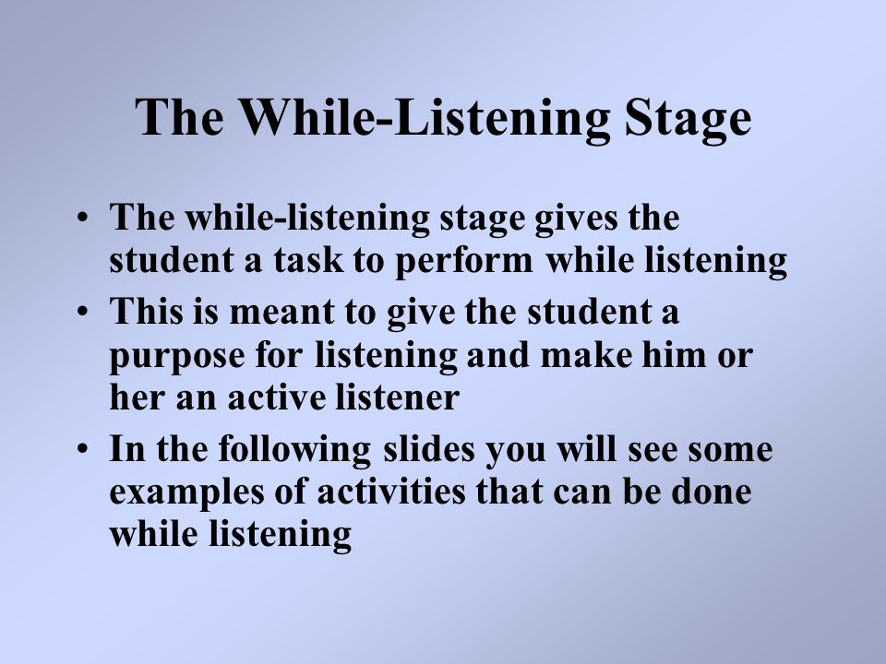
NOW THE NEXT STAGE IS WHILE LISTENING STAGE

Slide 14
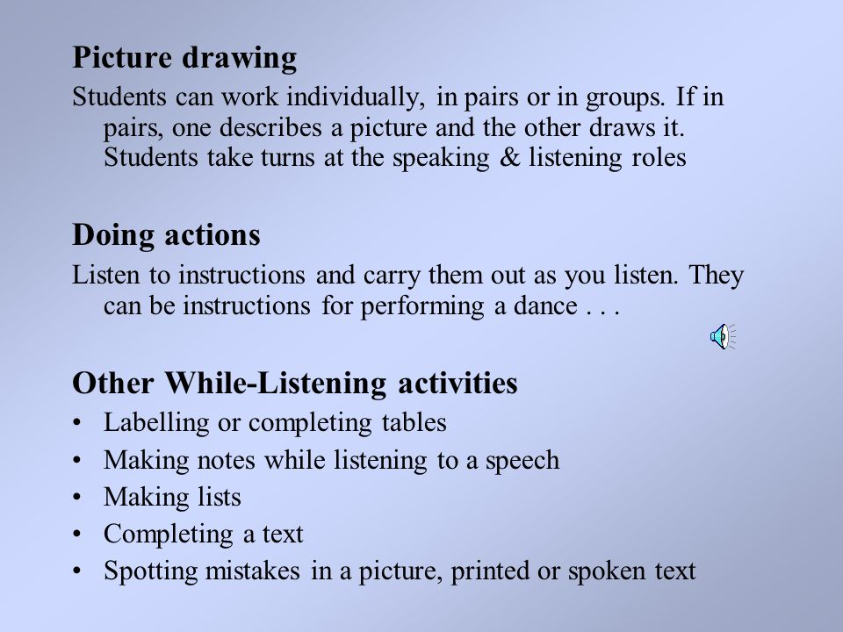
NOW LET’S START WITH EXAMPLES

Slide 15
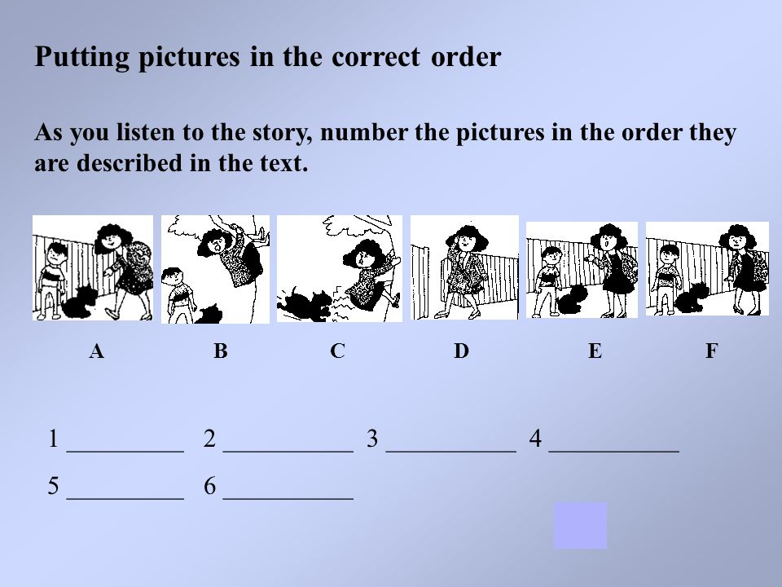
ONE MORE EXAMPLE

Slide 16
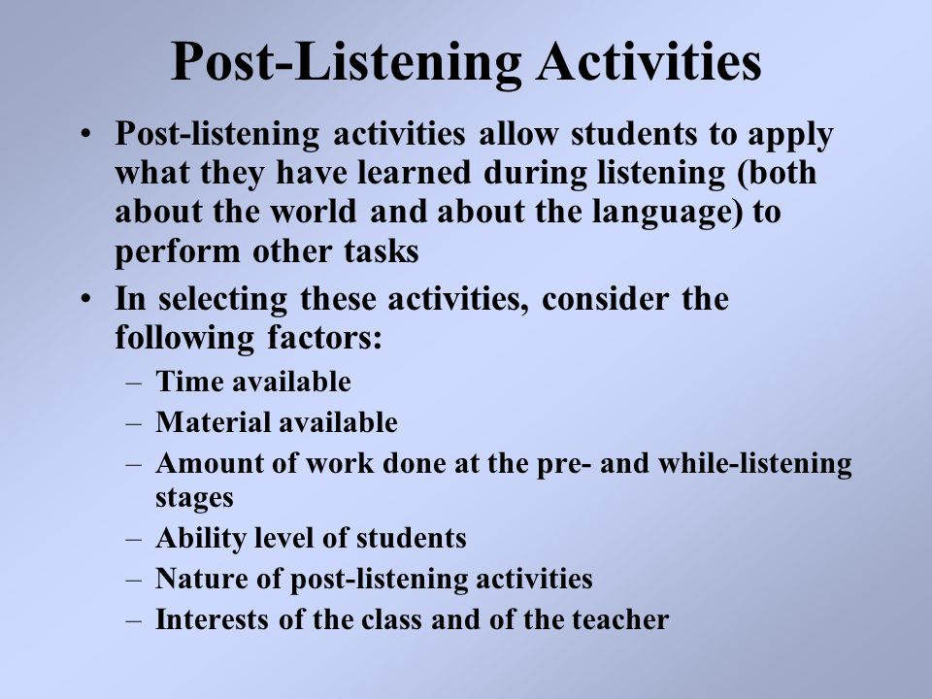
POST- LISTENING STAGE

Slide 17
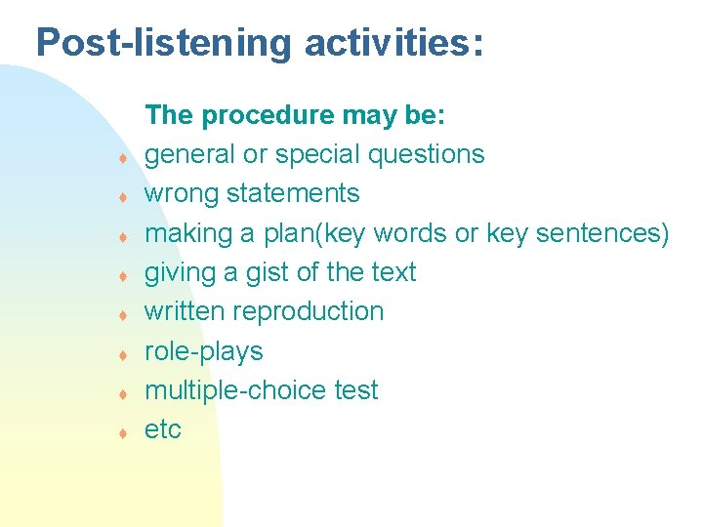
EXAMPLE

Slide 18
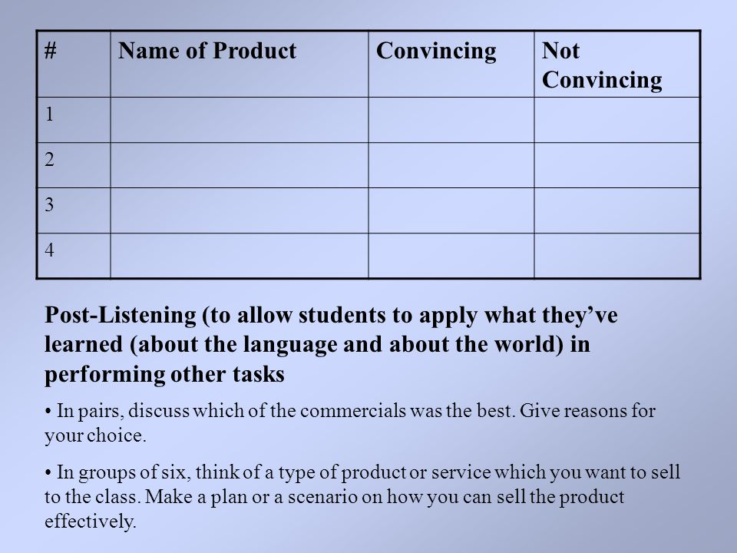
SOME MORE EXAMPLES

Slide 19
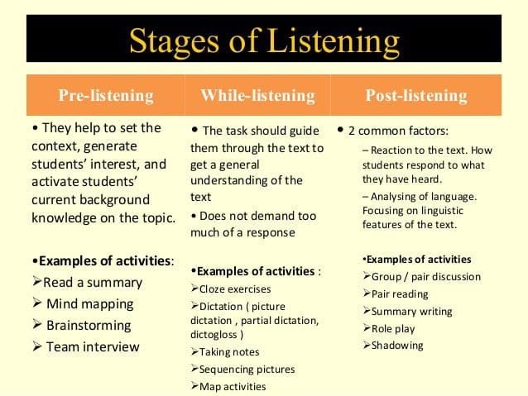
A BRIEF SUMMARY FOR YOU

Slide 20
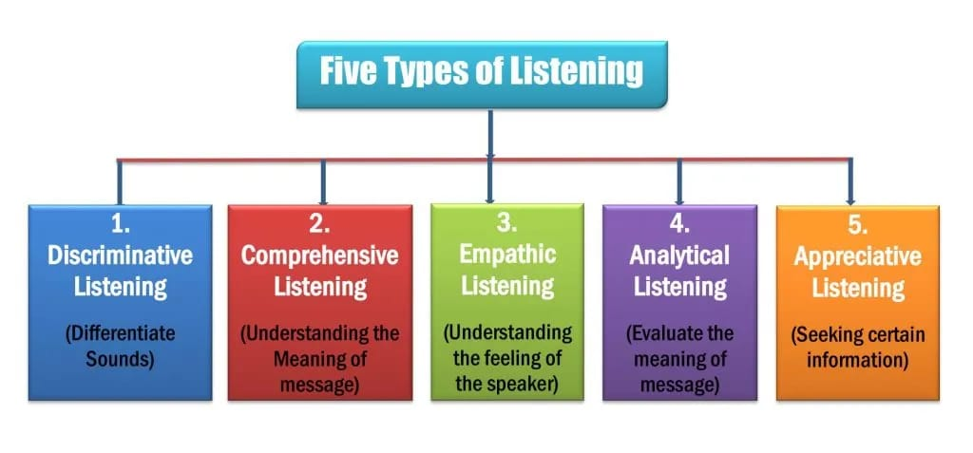
TYPES OF LISTENING

Slide 21
DISCRIMINATIVE LISTENING
Discriminative listening develops through childhood and into adulthood. As we grow older and develop and gain more life experience, our ability to distinguish between different sounds is improved. Not only can we recognise different voices, but we also develop the ability to recognise subtle differences in the way that sounds are made – this is fundamental to ultimately understanding what these sounds mean. Differences include many subtleties, recognising foreign languages, distinguishing between regional accents and clues to the emotions and feelings of the speaker.

Slide 22
COMPREHENSIVE LISTENING
Comprehensive listening involves understanding the message or messages that are being communicated. Like discriminative listening, comprehensive listening is fundamental to all listening sub-types
Comprehensive listening is complimented by sub-messages from non-verbal communication, such as the tone of voice, gestures and other body language. These non-verbal signals can greatly aid communication and comprehension but can also confuse and potentially lead to misunderstanding. In many listening situations it is vital to seek clarification and use skills such as reflection aid comprehension.

Slide 23
EMPATHIC LISTENING
Empathic listening involves attempting to understand the feelings and emotions of the speaker – to put yourself into the speaker’s shoes and share their thoughts.

Slide 24
ANALYTICAL LISTENING
Analytical listening is focused more on the interpretation and meaning of the actual sound.
Analytical Listening is about the ability and the capacity to properly analyse what is being said. This not only means understanding what the other person is saying and what they mean to say, but also being able to divide difficult questions into separate parts in order to get to the core.

Slide 25
APPRECIATIVE LISTENING
When you listen for appreciation you are listening for enjoyment. Think about the music you listen to. You usually listen to music because you enjoy it. The same can be said for appreciative listening when someone is speaking. Some common types of appreciative listening can be found in sermons from places of worship, from a motivational speech by people we respect or hold in high regard, or even from a standup comedian who makes us laugh.

Slide 26
ACTIVE LISTENING
What Is Active Listening?
In active listening, the listener pays full attention to the speaker and his words and makes an effort to understand the message. Active listening builds rapport, understanding and trust by actually hearing the message behind what the other person is saying, not just what you think they are saying or what you want to hear. The active listener spends more time listening than talking. However, he both listens and responds to the speaker, either through body language or words of his own.

Slide 27
PASSIVE LISTENING
In passive listening, the listener may appear to be listening to the speaker and her words but makes no effort to understand the message. Unlike the active listener, the passive listener is not paying attention. Whenever you listen to music while you are doing something else, such as studying or doing chores, you are passive listening. You may be aware of the music, but your attention is on your task.
A passive listener in a conversation or learning environment may accept and retain the information she hears but does not question or challenge the message or show interest through words or body language.

Slide 28
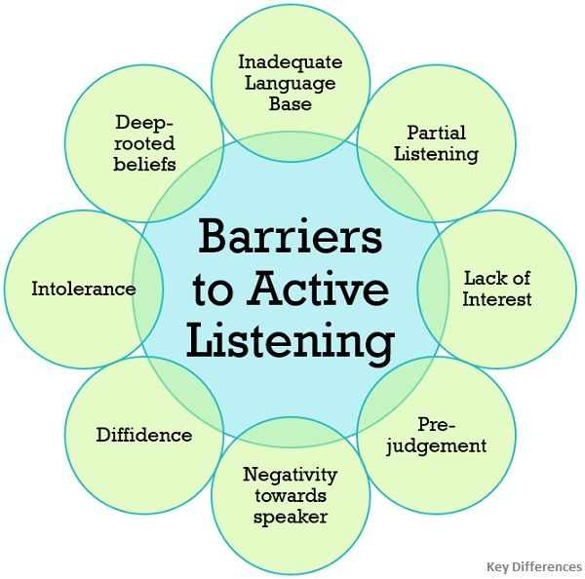
BARRIERS TO LISTENING

Slide 29
WAYS TO OVERCOME BARRIERS
Minimize distractions.
Prioritize listening over speaking.
Reduce outside noise.
Practice reflecting instead of deflecting.
Ask questions.
Listen fully before giving advice.

Slide 30
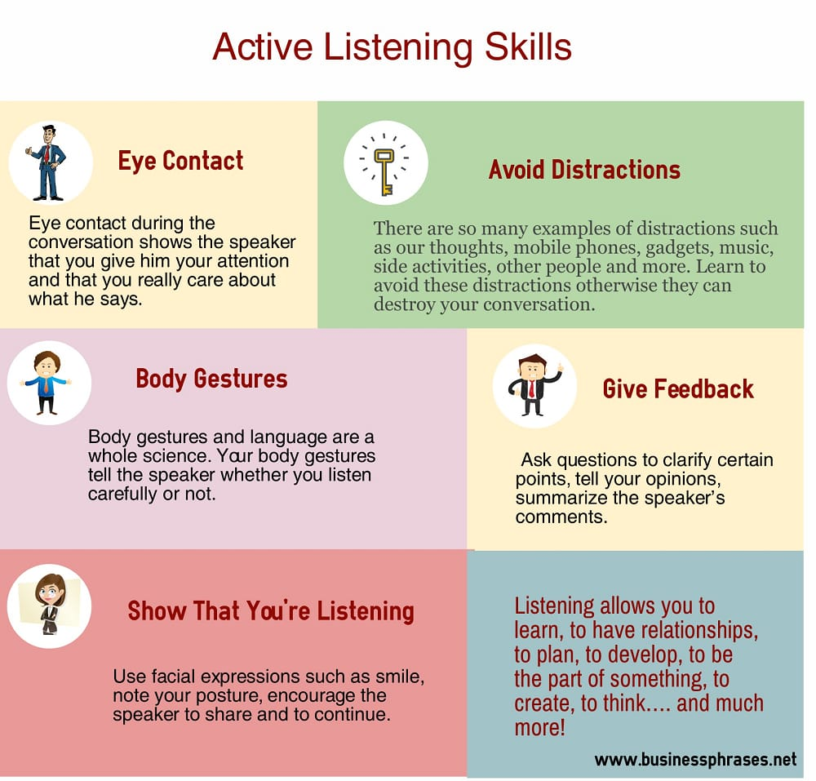
ACTIVE LISTENING SKILLS

Slide 31
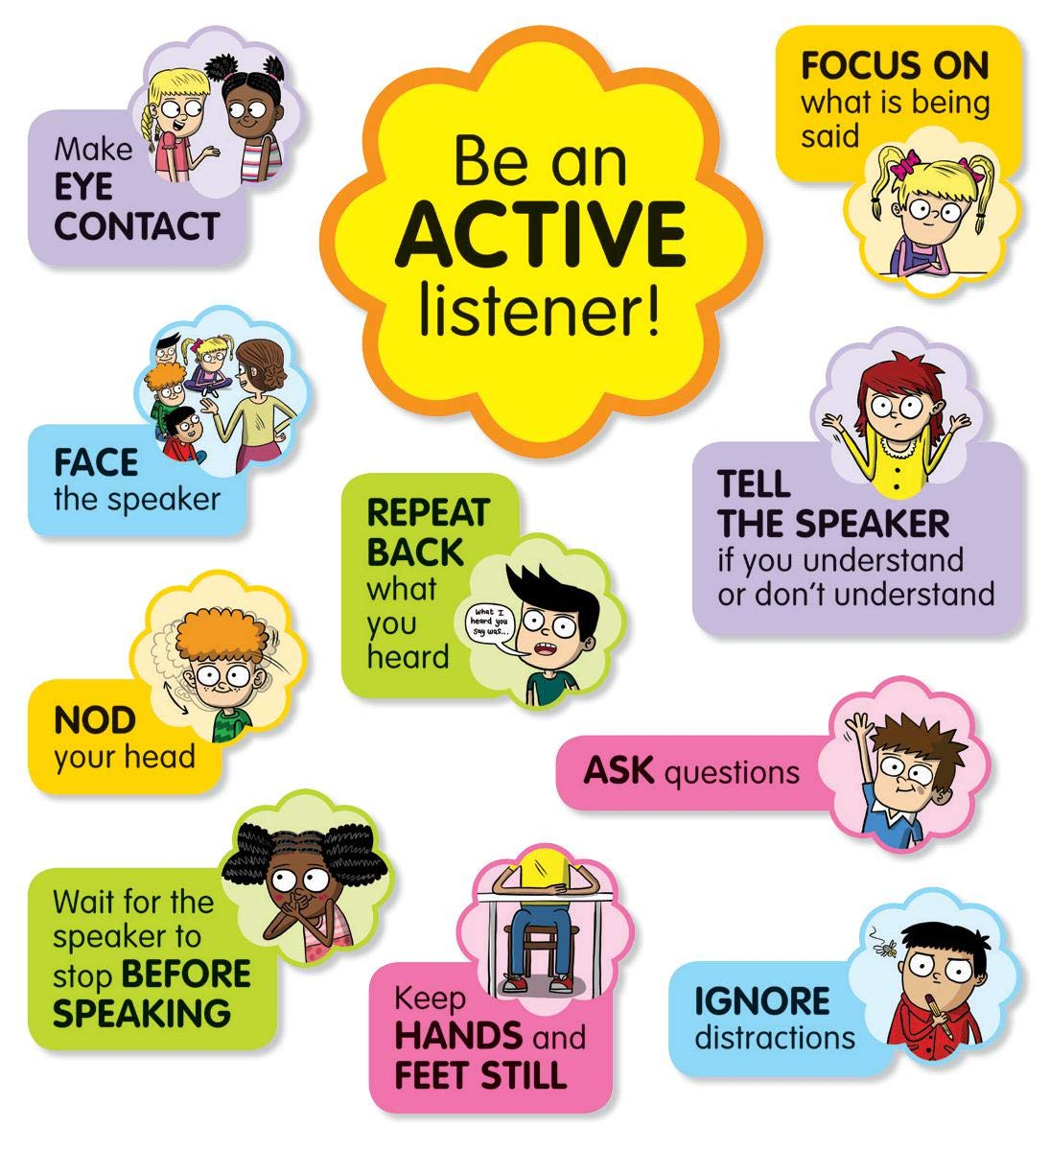
BE AN ACTIVE LISTENER !

Slide 32
THANK YOU FOR LISTENING TO MY PRESENTATION
ANY QUESTIONS

